Slide 1

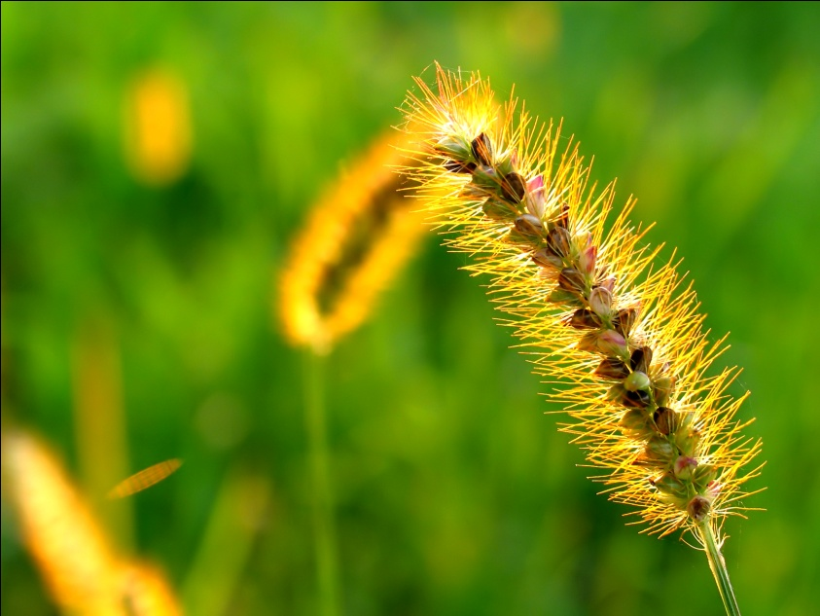
ALGORITMA HUNT in DECISION TREE
DATA MINING
In Classification

Slide 2
Introduction
Tree is a data structure contains of nodes and edges.
Nodes in a tree contains of 3 components:
Root node
Branch / internal node
Leaf node

Slide 3
Introduction
Decision tree represents simple classification for countable classes.
Root and internal nodes show independent attributes
Edges marked by class from the independent attributes
Leaf nodes represent the classes of dependent attribute

Slide 4
Introduction
An object (record) is classified by following a path from root node based on the attribute class in the record

Slide 5
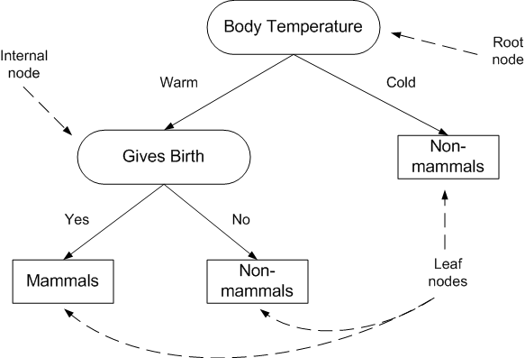
Example: Classification of Mammals

Slide 6
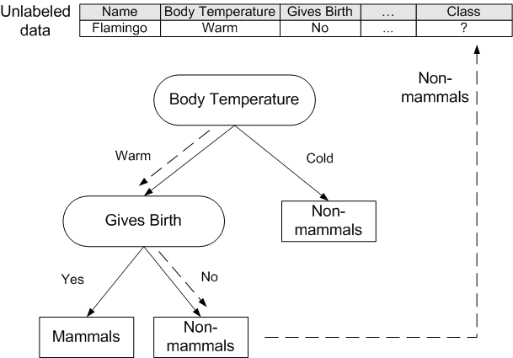
Example: Tracking the tree

Slide 7
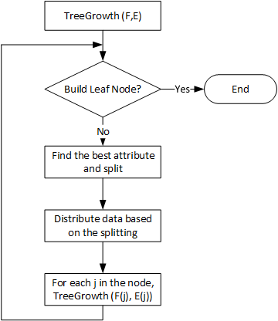
Decision Tree Algorithm

Slide 8
Hunt Algorithm
Hunt Algorithm is used to build a decision tree based on the induction such as ID3, C4.5 and CART.

Slide 9
Procedure of Hunt Algorithm
Suppose D_{t} is a set of training data reached a node t and y={y₁,y₂,…,y_{c}} is class label.
If all records in D_{t} having same class y_{t} then t is a leaf node labelled y_{c.}
If D_{t} is an empty set then t is a leaf node labelled default, y_{d.}

Slide 10
Procedure of Hunt Algorithm
If D_{t} contains of records having more than one class, use the attribute to split data into smaller partition set.
Apply the procedure recursively for each partition set.

Slide 11
Example
Id | Payment_Method (X1) | Status (X2) | Income (X3) (x10.000) | Class (Y)
1 | Yes | Single | 125 | No
2 | No | Married | 100 | No
3 | No | Single | 70 | No
4 | Yes | Married | 120 | No
5 | No | Divorced | 95 | Yes
6 | No | Married | 60 | No
7 | Yes | Divorced | 220 | No
8 | No | Single | 85 | Yes
9 | No | Married | 75 | No
10 | No | Single | 90 | Yes
Source: Hermawati, Fajar Astuti, 2013. Data Mining. CV. Andi Offset, Yogyakarta

Slide 12
Process of Hunt Algorithm
Node Dt = {1,2,3,4,5,6,7,8,9,10} categorized in 2 classes y = {yes,no}
Check whether all records in Dt having one class
Dt has more than one class, then split data using an attribute.
For instance = “Payment_Method (X1)”

Slide 13
Example
Id | Payment_Method | Status | Income (x10.000) | Class
1 | Yes | Single | 125 | No
2 | No | Married | 100 | No
3 | No | Single | 70 | No
4 | Yes | Married | 120 | No
5 | No | Divorced | 95 | Yes
6 | No | Married | 60 | No
7 | Yes | Divorced | 220 | No
8 | No | Single | 85 | Yes
9 | No | Married | 75 | No
10 | No | Single | 90 | Yes
Source: Hermawati, Fajar Astuti, 2013. Data Mining. CV. Andi Offset, Yogyakarta

Slide 14
Example
Id | Payment_Method | Status | Income (x10.000) | Class
1 | Yes | Single | 125 | No
2 | No | Married | 100 | No
3 | No | Single | 70 | No
4 | Yes | Married | 120 | No
5 | No | Divorced | 95 | Yes
6 | No | Married | 60 | No
7 | Yes | Divorced | 220 | No
8 | No | Single | 85 | Yes
9 | No | Married | 75 | No
10 | No | Single | 90 | Yes
Source : Hermawati, Fajar Astuti, 2013. Data Mining. CV. Andi Offset, Yogyakarta

Slide 15
Example
Id | Payment_Method | Status | Income (x10.000) | Class
1 | Yes | Single | 125 | No
2 | No | Married | 100 | No
3 | No | Single | 70 | No
4 | Yes | Married | 120 | No
5 | No | Divorced | 95 | Yes
6 | No | Married | 60 | No
7 | Yes | Divorced | 220 | No
8 | No | Single | 85 | Yes
9 | No | Married | 75 | No
10 | No | Single | 90 | Yes
Source : Hermawati, Fajar Astuti, 2013. Data Mining. CV. Andi Offset, Yogyakarta

Slide 16
Process of Hunt Algorithm
Attribute of Payment_Method (X1) has 2 classes ‘Yes’ and ‘No’, thus Dt will be:
Dt(X1=Yes)={1,4,7}
Dt(X1=No)={2,3,5,6,8,9,10}
Dt(X1=‘Yes’) ∪ Dt(X1=‘No’) = Dt _{Initial}
Dt(X1=‘Yes’) ∩ Dt(X1=‘No’) = { }

Slide 17
Example
Id | Payment_Method | Status | Income (x10.000) | Class
1 | Yes | Single | 125 | No
2 | No | Married | 100 | No
3 | No | Single | 70 | No
4 | Yes | Married | 120 | No
5 | No | Divorced | 95 | Yes
6 | No | Married | 60 | No
7 | Yes | Divorced | 220 | No
8 | No | Single | 85 | Yes
9 | No | Married | 75 | No
10 | No | Single | 90 | Yes
Source : Hermawati, Fajar Astuti, 2013. Data Mining. CV. Andi Offset, Yogyakarta

Slide 18
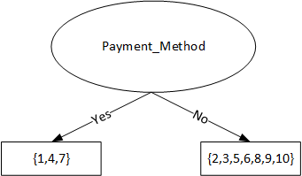
Initial Decision Tree

Slide 19
Process of Hunt Algorithm
Recheck step 2 for each Dt.
For example Dt=Dt(X1=‘Yes’)={1,4,7}
Due to Dt has the same class of ‘No’ in the Y label, thus the t node where Dt identified converted to leaf node labelled ‘No”

Slide 20
Example
Id | Payment_Method | Status | Income (x10.000) | Class
1 | Yes | Single | 125 | No
2 | No | Married | 100 | No
3 | No | Single | 70 | No
4 | Yes | Married | 120 | No
5 | No | Divorced | 95 | Yes
6 | No | Married | 60 | No
7 | Yes | Divorced | 220 | No
8 | No | Single | 85 | Yes
9 | No | Married | 75 | No
10 | No | Single | 90 | Yes
Source: Hermawati, Fajar Astuti, 2013. Data Mining. CV. Andi Offset, Yogyakarta

Slide 21
Process of Hunt Algorithm

Slide 22
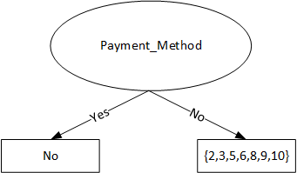
Process of Hunt Algorithm

Slide 23
Process of Hunt Algorithm
Recheck step 2 for each Dt. For example Dt=Dt(X1=‘No’)={2,3,5,6,8,9,10}
Dt has more than 1 class, thus, thus we need to split using other attribute, e.g. Status (X2)

Slide 24
Process of Hunt Algorithm
Attribute ‘Status’ have 3 classes, will be split:
Dt(X2=‘Single’)={3,8,10}
Dt(X2=‘Married’)={2,6,9}
Dt(X2=‘Divorced’)={5}

Slide 25
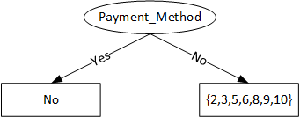
Process of Hunt Algorithm

Slide 26
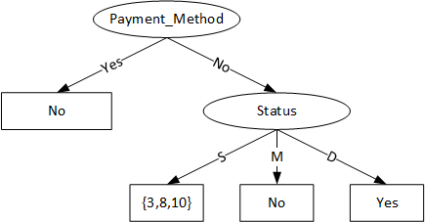
Process of Hunt Algorithm

Slide 27
Process of Hunt Algorithm
Dt={3,8,10} still has 2 classes, thus we need other splitting using attribute “Income (X3)” categorized into binominal classes ‘<=80’ and ‘>80’
Dt(X3<=80)={3}
Dt(X3>80)={8,10}

Slide 28
Decision Tree

Slide 29
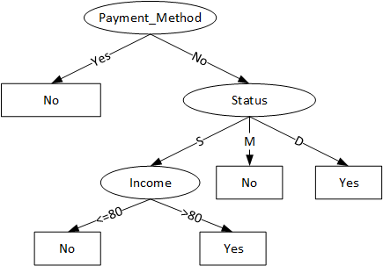
Decision Tree

Slide 30
Exercise
Build a decision tree using hunt algorithm for the following dataset:
# | Color | Type | Manufacture | Stolen?
1 | Red | Sport | Local | Yes
2 | Red | Sport | Local | No
3 | Red | Sport | Local | Yes
4 | Yellow | Sport | Local | No
5 | Yellow | Sport | Import | Yes
6 | Yellow | SUV | Import | No
7 | Yellow | SUV | Import | Yes
8 | Yellow | SUV | Local | No
9 | Red | SUV | Import | No
10 | Red | Sport | Import | Yes

Slide 31
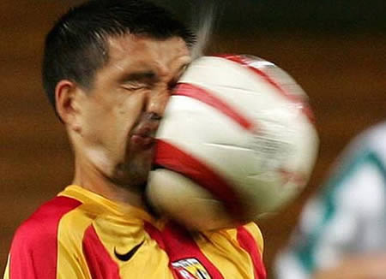
Is that simple?
NOOO!!!!

Slide 32
How to define the best attribute?
Attribute
Information Gain
Gain Ratio
Gini Index
See you
next meeting

